Slide 1
Achieving BPM Success
Malcolm Garbutt, Malika Kalam, Jessica Ling,
Nkosekhaya Mfini and Marc Pelteret
Enterprise Systems and BPM (INF4012W)
1 July 2011

Slide 2
Introduction
Business process improvement: #1 on Gartner’s CIO Agenda survey (2007 to 2010)
BPM
  The key to process improvement
  Management approach supported by technology
  Intended to align processes with organisation’s strategic objectives and customers’ needs
  Affects the organisation as a whole

Slide 3
Strategy
PROCESS SUCCESS
BUSINESS SUCCESS
Culture
Process Efficiency
Business Efficiency
People/ Resources
Context
Process Quality
Client Experience
BPM ENABLERS
Governance
Process Agility
Business Agility
IT
Thompson, Seymour and O'Donovan’s BPM success model
Methods

Slide 4
Strategy
PROCESS SUCCESS
BUSINESS SUCCESS
Culture
Process Efficiency
Business Efficiency
People/ Resources
Context
Process Quality
Client Experience
BPM ENABLERS
Governance
Process Agility
Business Agility
IT
Methods

Slide 5
Strategy — the why
Enabling
  Translates strategy into specific needs
  Enables execution of strategy
  Gains funding for projects
Non-enabling
  Limits business case development
  Limits funding
  Misalignment of business and processes

Slide 6
Strategy — the how
Strategic alignment
  Clear link between strategy and processes
  Review processes when strategy is altered
Driven from the top
Comprehensive BPM strategy
  Pre-requisite — awareness of the processes dimension
  BPM Strategy must exist
  It must be communicated — promotes culture of continuous improvement
  Process improvement methodology must be developed
Processes must be measured for increased effectiveness and alignment
COE/PMO — co-ordination, integration, repository for knowledge and good practices, central funding

Slide 7
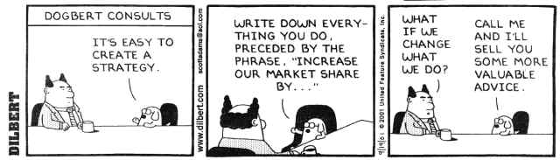
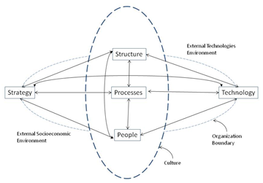
Strategy — the 3 Scotts
Scotsman — dinna’ spend
Scott Adams
Scott Morton

Slide 8
Strategy
PROCESS SUCCESS
BUSINESS SUCCESS
Culture
Process Efficiency
Business Efficiency
People/ Resources
Context
Process Quality
Client Experience
BPM ENABLERS
Governance
Process Agility
Business Agility
IT
Methods

Slide 9
Culture
BPM is an organisational business change
Employees’ perception of BPM
Cross-functional teamwork
“Work smarter, faster, more consistently and with more focus on value creation”
Delivering customer satisfaction

Slide 10
Strategy
PROCESS SUCCESS
BUSINESS SUCCESS
Culture
Process Efficiency
Business Efficiency
People/ Resources
Context
Process Quality
Client Experience
BPM ENABLERS
Governance
Process Agility
Business Agility
IT
Methods

Slide 11
People / resources
Organisation’s understanding of BPM
Holistic knowledge
Training and communication
Limited IT resources

Slide 12
Strategy
PROCESS SUCCESS
BUSINESS SUCCESS
Culture
Process Efficiency
Business Efficiency
People/ Resources
Context
Process Quality
Client Experience
BPM ENABLERS
Governance
Process Agility
Business Agility
IT
Methods

Slide 13
Governance
Establishment of
  Relevant and transparent accountability
  Decision-making
  Reward processes
How: identify key processes and assign process owners
  Manage relationships with department managers
Needs to be clear definition of roles, duties and responsibilities
Well-defined reward and remuneration policy
Centre of excellence for process improvement
There can be formal and informal means of governance

Slide 14
Strategy
PROCESS SUCCESS
BUSINESS SUCCESS
Culture
Process Efficiency
Business Efficiency
People/ Resources
Context
Process Quality
Client Experience
BPM ENABLERS
Governance
Process Agility
Business Agility
IT
Methods

Slide 15
Information technology
Enables and support lifecycle of BPM project
  Design, implementation, measurement, improvement, project management
Some selection criteria for a good BPM system
  Successfully implemented by other organisations
  Cost of the system
  Support offered by the vendor
Architecture of the system should be carefully chosen to reduce support complexity
Good system should support BPEL for Web Services and BAM

Slide 16
Strategy
PROCESS SUCCESS
BUSINESS SUCCESS
Culture
Process Efficiency
Business Efficiency
People/ Resources
Context
Process Quality
Client Experience
BPM ENABLERS
Governance
Process Agility
Business Agility
IT
Methods

Slide 17
Methodology
Approaches used to support and enable consistent process actions.
Lifecycle of BPM project
Design and modelling
Implementation and execution
Control and measurement
Improvement and innovation
Process management

Slide 18
Methodology
BPM lacks a holistic methodology
Organisational culture and technology can assist with identifying methodology
Current methodologies could act as a foundation to formulating a BPM methodology
The methodology must cover the whole process improvement lifecycle

Slide 19
Strategy
PROCESS SUCCESS
BUSINESS SUCCESS
Culture
Process Efficiency
Business Efficiency
People/ Resources
Context
Process Quality
Client Experience
BPM ENABLERS
Governance
Process Agility
Business Agility
IT
Methods

Slide 20
Conclusion
Key: alignment of organisation’s strategy and core processes
Comprehensive, well-communicated BPM strategy
Culture that supports continuous improvement
Good governance policy
BPMS that supports standards
Organisation needs to develop its own methodology

Slide 21
Strategy
PROCESS SUCCESS
BUSINESS SUCCESS
Culture
Process Efficiency
Business Efficiency
People/ Resources
Context
Process Quality
Client Experience
BPM ENABLERS
Governance
Process Agility
Business Agility
IT
Methods

