Slide 1
PRIVACY
Notes:
Privacy as we understand it today is not how it was understood yesterday, nor will it be the same as we will understand it tomorrow.

Slide 2
PRIVACY
// AN EVER-EVOLVING CONCEPT
Notes:
It’s an ever-evolving concept that is often influenced by political and technological features of the society’s environment

Slide 3
PRIVACY
// THE RIGHT TO BE LET ALONE
Notes:
In 1890, Warren & Brandeis defined it as “the right to be let alone”.
At that time, newspapers were the threat: they were publishing photographs of and statements by individuals without their consent.
Today, information technology is seen as the danger

Slide 4
PRIVACY
// ACCESSIBILITY (PHYSICAL)
// DECISIONAL
// PSYCHOLOGICAL (MENTAL)
// . . .
Notes:
Tavani lists four views of privacy:
Accessibility privacy, also called physical privacy – freedom from intrusion into one’s physical space.
Decisional privacy – freedom from interference with one’s choices.
Psychological privacy, also known as mental privacy – freedom of intrusion upon and interference with one’s thoughts and personal identity.

Slide 5
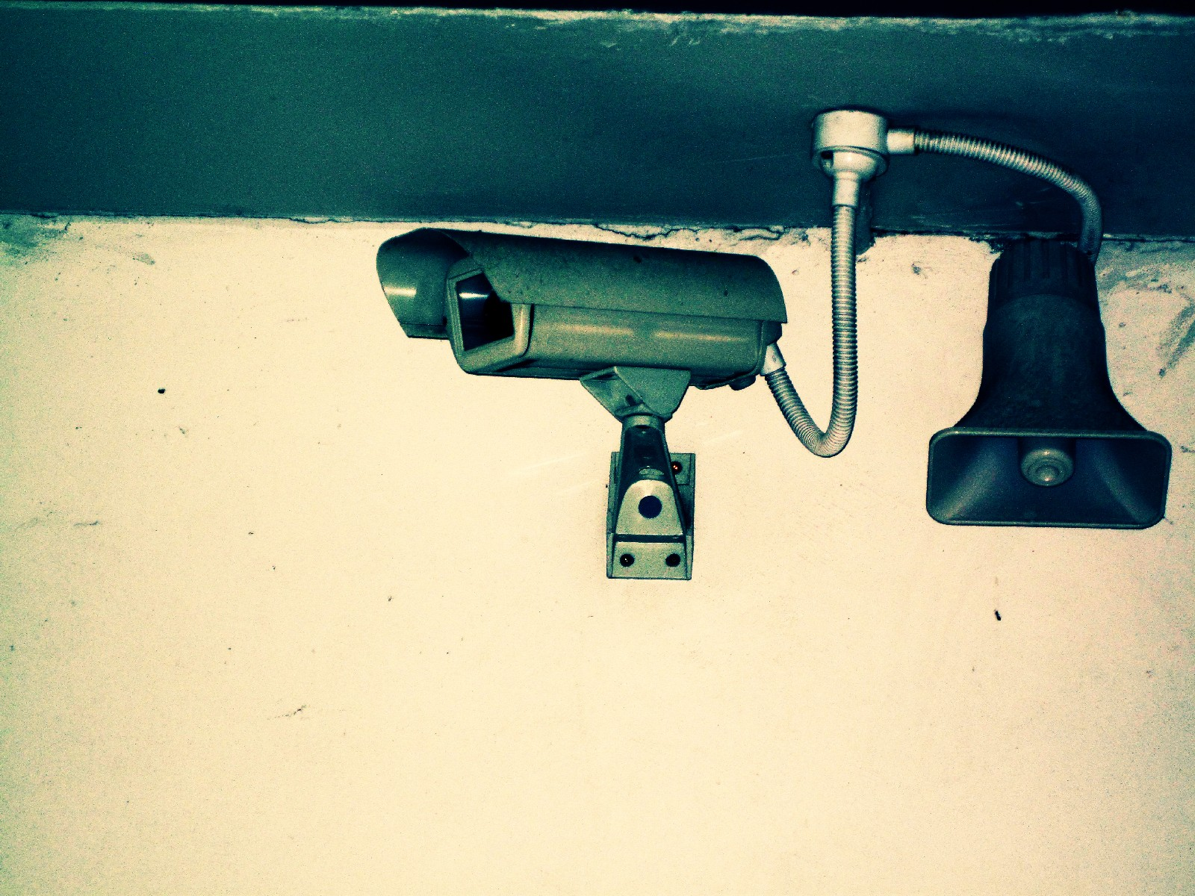
INFORMATIONAL PRIVACY
Presented on 24 October 2011 by Marc Pelteret
Notes:
Having control over and being able to limit access to one’s personal information
In today’s world, we simultaneously seek privacy while having to disclose personal information in order to receive services, such as health care and insurance, and establish friendships.
Online communication and the Social Web have led us into the habit of sharing large amounts of information with great number of people, and yet many of us do not feel threatened when doing so.

Slide 6
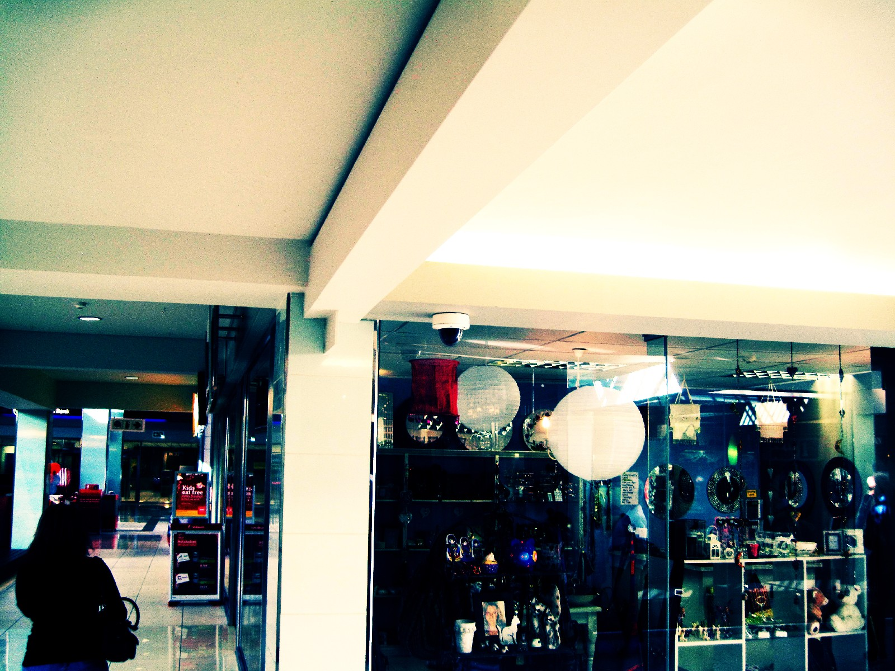
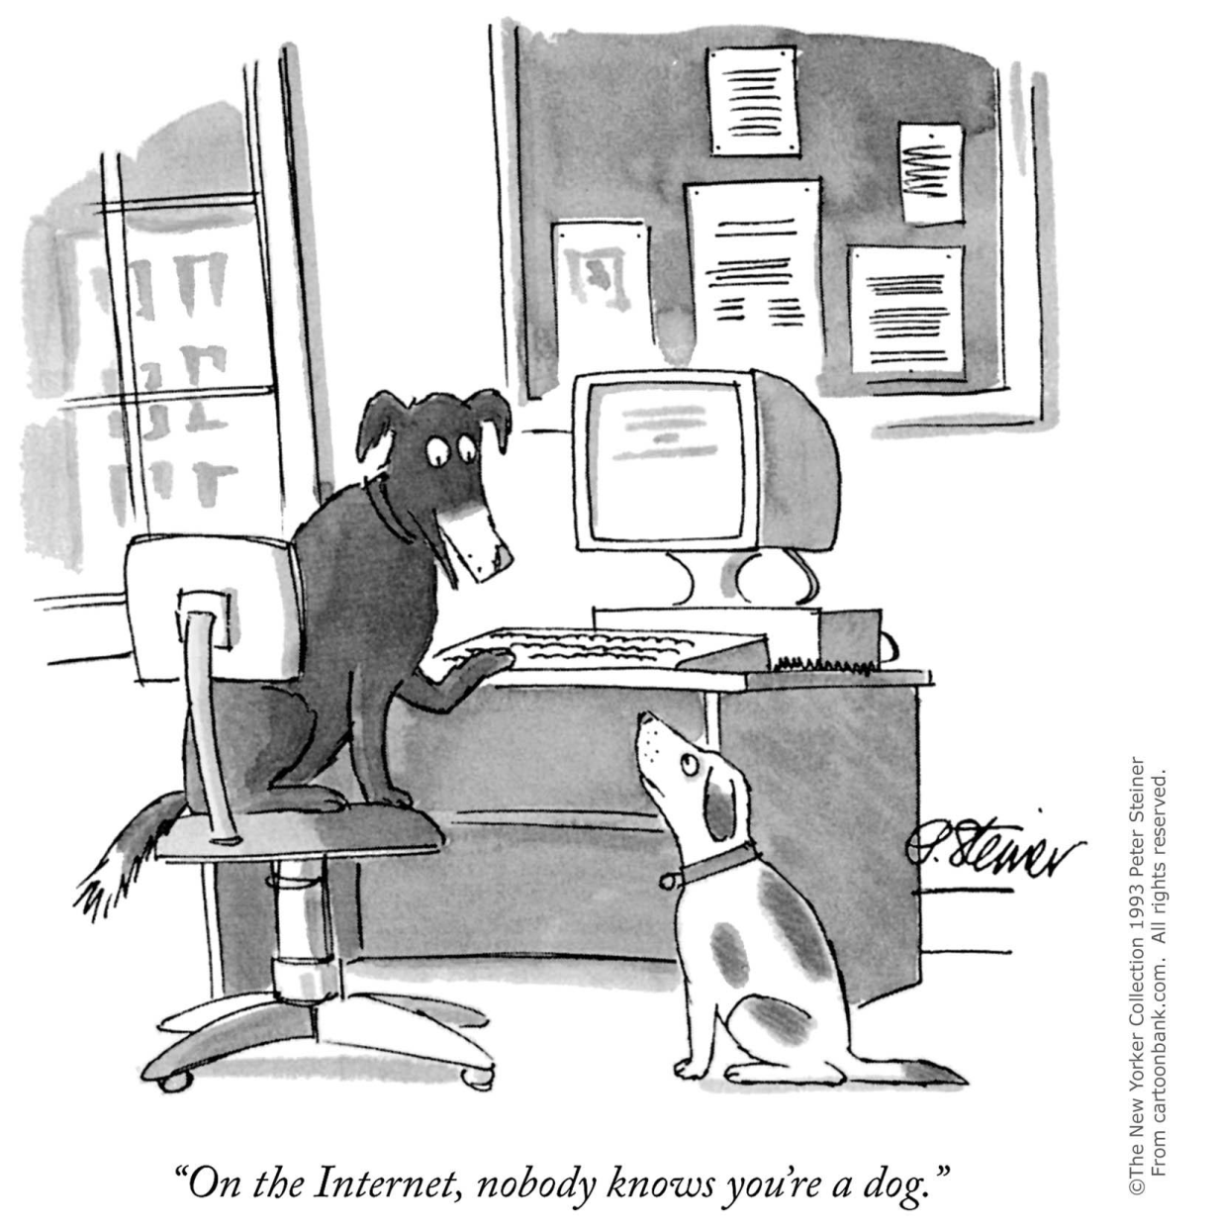
Notes:
This was truer back in 1993 when this was drawn than it is today.
Today, it’s not unlikely that someone somewhere not only knows he’s a dog, but knows his favourite kind of food, his favourite toy, how he likes to be scratched, and so on.

Slide 7
Amount of data
Speed of exchange
Length of time can be retained
Kind of information that can be acquired
Notes:
The same technology that allows us to share with others makes it easier than ever to collect vast amounts of data.
Of cause for concern are [the list]

Slide 8
Theories of privacy
Complexities of making decisions about privacy
Some privacy issues

Slide 9

PRIVACY THEORIES
Notes:
Privacy has been and continues to be analysed from a variety of perspectives – law, medicine, psychology, sociology, political science, and economics.
Will look at three sociological theories, the economic “free market” theory and an informational theory.

Slide 10

Westin’s theory
Need privacy to adjust to emotionally to inter-personal interactions
Notes:
Westin defines privacy as “the voluntary and temporary withdrawal of a person from the general society through physical or psychological means”.
People need privacy in order to adjust emotionally to inter-personal interactions, and it is a dynamic process (over time, we regulate it to meet short-term and long-term needs) and a non-monotonic function (it is possible to have too little, enough or too much privacy).
Privacy operates at the individual, group and organisational levels

Slide 11
Altman’s theory
Concentrates on individual and group privacy and behaviour
Notes:
Altman’s analysis of privacy concentrates on individual and group privacy and behaviour.
Multiple behavioural mechanisms for regulating privacy that operate as a coherent system, meaning that one mechanism can substitute for, amplify or modulate another. For instance, a nod can replace the word “yes” or slamming a door after shouting “no” reinforces the word).
Three features of privacy are important in Altman’s theory.
1. Privacy is a social process.
2. Privacy has a cultural context.
3. In order to understand the psychological aspects of it one needs to look at, amongst other things, the interaction between people, their social world, the physical environment, and the time-based nature of social events.

Slide 12
Petronio’s communication privacy management
Privacy boundaries with varying degrees of permeability
Notes:
* Petronio developed a theory known as communication privacy management, which is based on Altman’s work and is very valuable in understanding computer-mediated communication.
* Permeability (openness) depends on what sort of access we want to give to personal information.
* Tension between boundaries because if simultaneous need to be open and social and as well as to be private and preserve our autonomy. Continually adapt these boundaries according internal states and external conditions.
We make these adjustments according to six principles: (1) we own our private information; (2) because of this, we have the right to control it; (3) we use rules to control the flow of private information; (4) once we share that information, those we share it with become co-owners (5) once it is co-owned, there are rules governing sharing it with others (we usually expect the co-owner to act according to our original rule; however, these rules can be dynamic and implicit or explicit); (6) Because we often don’t explicitly agree upon co-ownership rules, we can end up with boundary turbulence – disruptions in the way co-owners manage the flow of information to third parties.

Slide 13
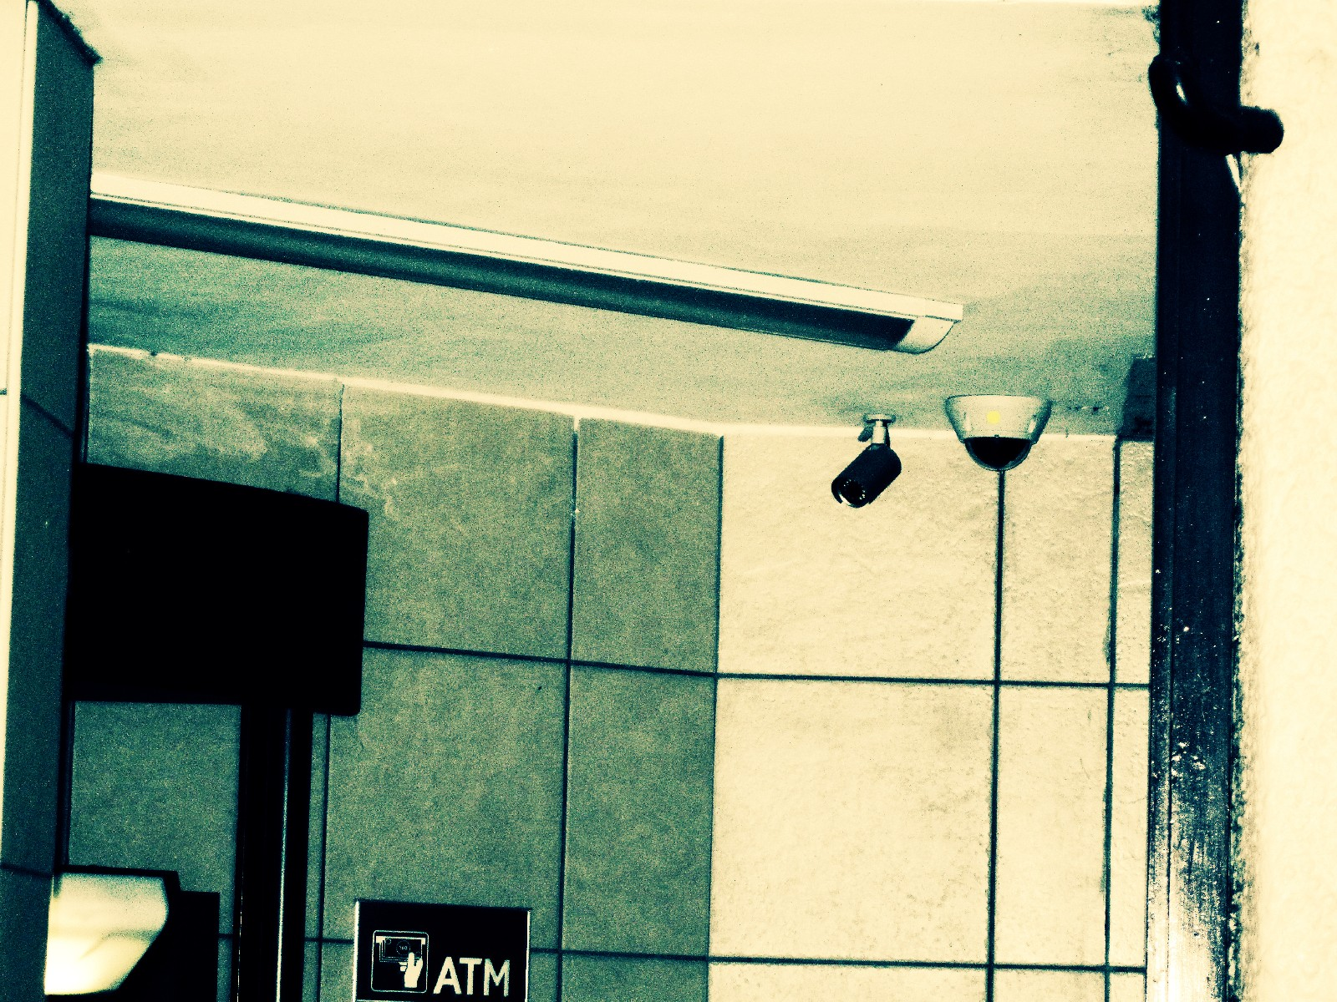
Economic “free market” theory
More information is better – leads to market efficiency
Notes:
Particularly appropriate discipline to use when analysing the concept of privacy – allows one to appreciate the key trade-offs in policy toward privacy.
“Chicago School” of thought contends that privacy should be treated as any other good: a “free market” approach should be applied to it and this market will be efficient. In a free market, more information is better, provided it is obtained without cost. Thus privacy is generally considered inefficient.
Proponents of the approach are opposed to government regulation as it stops information flows that will lead to economic efficiency.
Several reasons why this approach may not work efficiently:
* Perfect information may destroy markets based on risk and asymmetric information (e.g., health insurance).
* The argument only works when sellers have perfect information about consumers, for less than perfect information can affect efficiency.
* It overlooks the fact that resources must be used in order to collect personal information and the collection may have negative consequences for consumer welfare.

Slide 14

Restricted Access / Limited Control theory
Zones to limit access others have to info
Control important, but not part of definition of privacy
Notes:
A person has privacy in a particular situation if they are protected from intrusion, interference and information access by others.
Emphasises the importance of setting up zones that allow individuals to limit the access others have to their information.
Also recognises the importance of individual control. However, it does not build the concept of control into the definition of privacy, nor does it require that individuals have full or absolute control over their personal information in order to have privacy; instead, only limited controls are needed to manage one’s privacy.
Specifically, the individual has control over choice, consent and correction: they need to be able to choose situations that offer others the level of access they desire – for example, to choose to waive the right to restrict others from accessing certain kinds of information about them – and they need to be able to access their information and correct it if necessary.
These are only a few of many theories on privacy.

Slide 15

CHALLENGES IN PRIVACY DECISION-MAKING
Notes:
Ensuring privacy is a complex decision-making process and may differ from one individual or instance to another. A variety of issues influence decisions regarding privacy and can lead to inconsistencies and contradictions.
Specifically, individuals will face three problems: incomplete information, bounded rationality and psychological distortions.

Slide 16
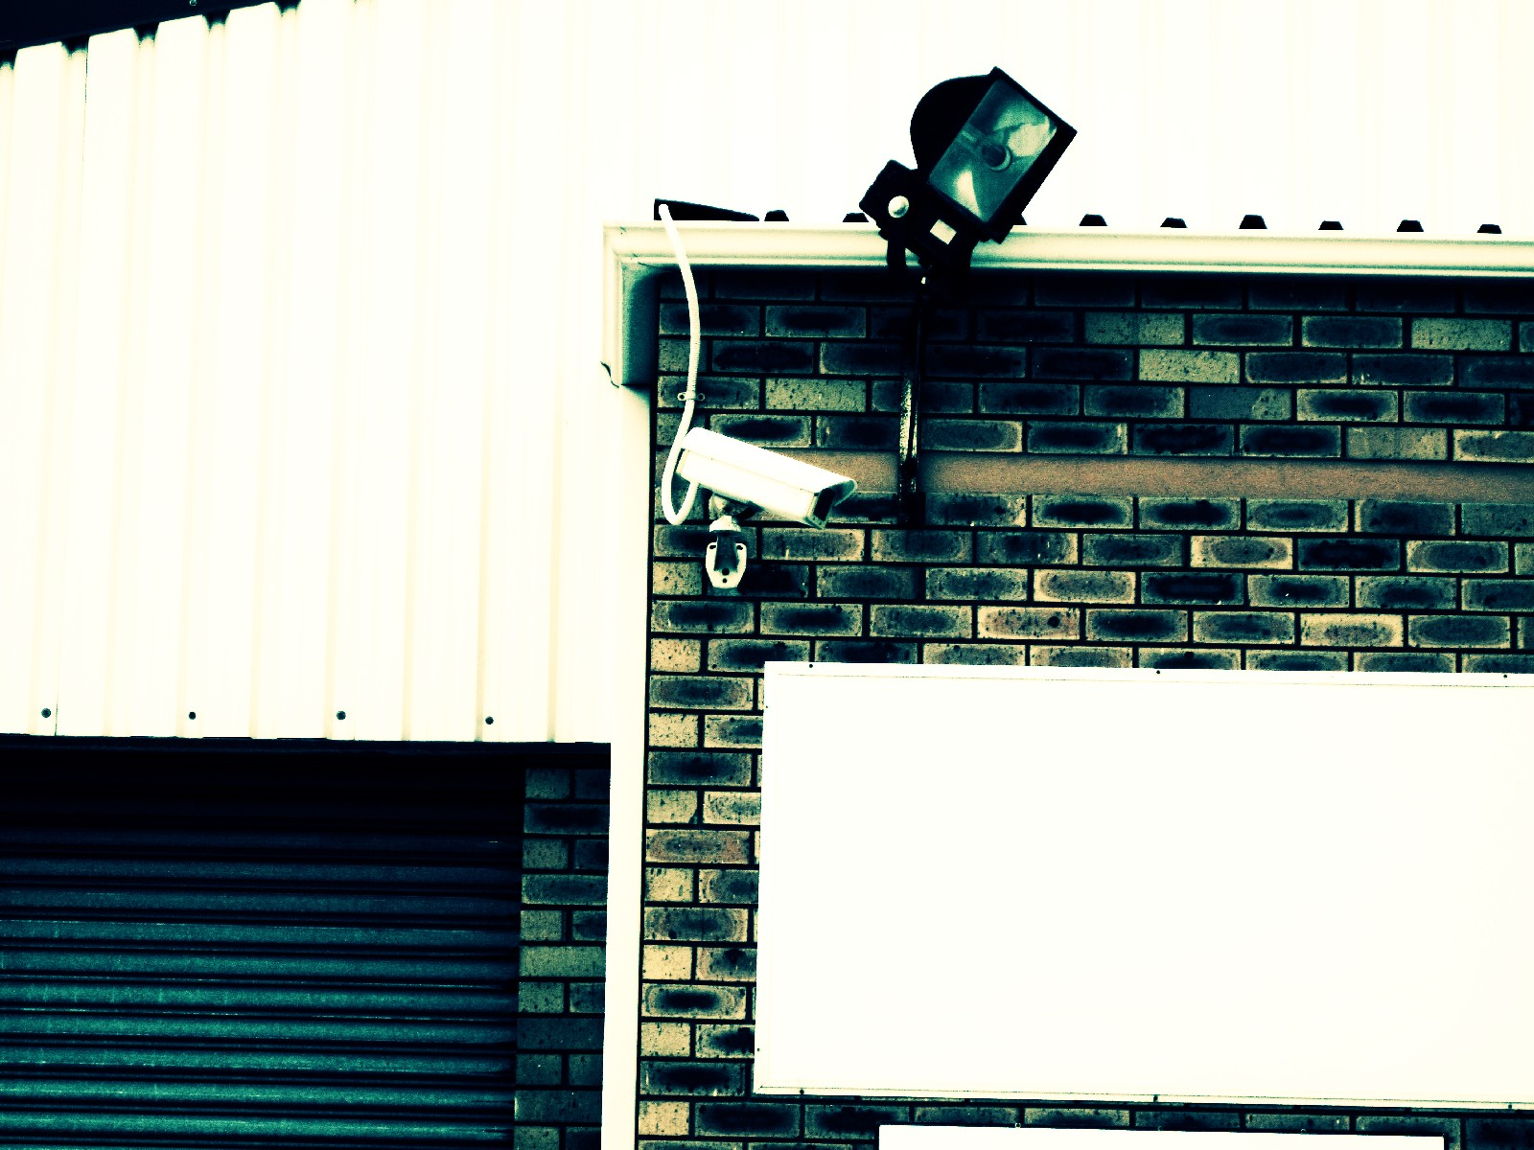
Incomplete information
Parties do not have same information
Cost/benefit analysis difficult
Notes:
This is where the different parties involved in a transaction don’t have the same information about it and may be uncertain about certain parts of it.
Privacy intrusion and protection are often bundled with other goods and services, and so it can be difficult to get specific information on privacy.
Incomplete information makes it difficult to perform a cost-benefit analysis when making a decision.

Slide 17
Bounded rationality
Difficult to evaluate all information and calculate payoffs
Notes:
Refers to the fact that it is extremely difficult to evaluate all the information we are given about a privacy-sensitive situation and calculate the magnitude of payoffs that come with different actions. We particularly struggle to weigh up probabilities.
The “rational man” used in economics is assumed to always be rational and have the ability to process all information; in reality, people do not work this way.
Often payoffs may only be determined through actual experience. In addition, many probability values may be almost entirely subjective.

Slide 18
Psychological distortions
Influence thinking and decision-making
Notes:
Even if an individual has access to complete information and could process all of it, they may still find it difficult to follow a rational strategy because of psychological distortions that influence their thinking.
There are numerous types of distortions: tendency to under-insure against certain risks; individuals are often loss adverse: prefer to avoid a loss than acquire a gain; optimism bias: incorrectly perceive their risks to be lower than those of others in a similar situation.
So, whenever an individual has to make a decision about privacy, they rarely have all the information they need to make an informed choice. But even if they did, it is unlikely they would be able to process all of it – and even if they could, they may well not make a rational decision. The result is that we tend to use simplified models when making privacy decisions.

Slide 19
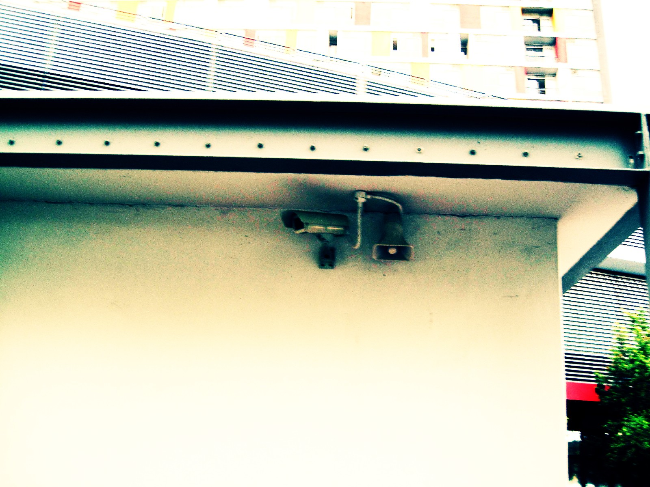
INFORMATION PRIVACY ISSUES

Slide 20

Profiling and price discrimination
Websites track visitors, use information to profile them
Often used for targeted advertising, but can be used for price discrimination
Notes:
Websites track their visitors’ behaviour and interaction with the sites using cookies, server-side logging and clickstream data, which record what a user clicks on while using the site. Search behaviour is also often recorded. Using this information, websites can profile visitors.
This profiling can be used to better serve consumers by identifying their needs and save expense for sellers – for example, targeted advertising, where consumers are shown adverts about goods they would actually be interested in.
But this information can also be used to institute price discrimination. Given the power of computer systems and the speed of networks today, customers can be offered prices, coupons and recommendations personalised for them and in real-time.

Slide 21

Secondary use of information
Customer information sold to third parties
Aligned incentives between buyer and seller, but not between seller and third party
Possible solutions: property rights, opt-in/out systems
Notes:
Increasingly, organisations sell customer information to third parties – for example, TiVo tracks the viewing habits of individuals and sells this information to Nielsen Media, which uses it to determine viewer numbers for programmes. This is called secondary use of information.
The issue is that while the buyer and seller have incentives that are more or less aligned, the incentives of the seller and third party are not so well aligned. An example of this is the sale of a mailing list, something that often leads to spam.
One method of dealing with this issue is to assign property rights in personal information to individuals, but then allow contracts to be written to allow and control use of their information. But property rights come with issues, such as how does one value such a right?
Another approach is the use of opt-in and opt-out systems, where an individual must explicitly give or deny someone permission to collect their data.

Slide 22

Identity theft
Made possible by modern payment systems
Trade today more dependent on consumer data
Notes:
Identity theft is made possible by the nature of modern payment systems. Sellers are willing to offer goods and services to individuals they don’t know in exchange for the promise to pay. This promise must be backed up a specific account or credit history, which is linked to the individual through data. If someone is able to acquire enough of this data, they can forge the link.
While such anonymous transactions have been available for decades through the use of credit cards, trade has become more dependent on ready access to consumer data. For businesses, the costs of storing and transmitting data have dropped dramatically over time, making it easier to confirm identities and fight fraud, but at the same time this increase in data transmission and flow make identity theft more appealing.
Identity theft can result in a range of issues, from existing accounts and credit cards being exploited, to misrepresentation (for example, one person posing as another when renting a car), to new accounts being opened in one’s name. Often a consumer is not aware of a problem until they apply for credit, check their credit report or receive an account. They then have to expend time, effort and often money to rectify the problem.

Slide 23

Data breaches
Numerous attacks on large databases – e.g., Sony
Breach disclosure law an important topic
Notes:
In recent months, there have been numerous attacks on large databases containing personal information. In April, Sony’s PlayStation Network database holding details of its 70 million users was breached. Sony was targeted again in June: this time the private details of one million people who had entered competitions on SonyPictures.com were taken and published on the Internet.
Data breaches such as these are occurring with increasing frequency. This data can be used in a variety of ways, including being sold to spammers and to perpetrate identity theft.
Breach disclosure has become an important topic for discussion, and in many countries regulation has been implemented to make it mandatory to notify individuals when their personal information has been acquired by an unauthorised party. These laws are intended to have two effects: incentivise firms to invest in counter-measures and help individuals affected by a breach to mitigate the effect of it.

Slide 24

CONCLUSION
Continuously-evolving issue
Numerous perspectives/theories
Evaluating privacy is complex
Many dangers involving personal information
Notes:
The concept of privacy has transformed and evolved over time and in today’s information age, the privacy of personal information has become of paramount importance. We all face the simultaneous need to maintain privacy and reveal personal information in order to interact socially and form relationships.
Informational privacy is essentially about having control over one’s personal information and being able to limit, as we see fit and depending on the situation, the access others have to it. Amongst other things, this can affect how this data is stored and communicated in telephonic and digital systems.
There are numerous theories regarding the nature and manifestation of privacy (looked at Westin, Altman and Petronio; economic “free market” theory; Restricted Access/Limited Control theory)
Making decisions about privacy, its implementation and its impact is not a straight-forward process: it involves a variety of issues to do with incomplete information, bounded rationality and psychological distortions. These affect the thinking of even the most sophisticated and rational of individuals and can lead to inconsistencies and contradictions in decision-making.
There are numerous complexities surrounding informational privacy and we looked at a selection of them: profiling of customers; secondary use of information by third parties – spam being a particular worry here; identity theft; data breaches.
To conclude, informational privacy is an important and complex issue that affects the lives of everyone in our information-orientated society. And as society and technology progress, inevitably it is going to become more complex and as such require on-going thought, research and intellectual engagement.

Slide 25

Civilisation is the progress toward a society of privacy. The savage's whole existence is public, ruled by the laws of his tribe. Civilisation is the process of setting man free from men.
– Ayn Rand
Notes:
Through an on-going consideration of the nature and implementation of informational privacy we will seek to find the right balance between the demands of the individual and the society in which we live.

